Slide 1

SOCIAL MEDIA ANALYSIS
By MEGANATHAN R

Slide 2
INTRODUCTION TO INSTAGRAM
What is Instagram?
A globally dominant, mobile-first social network focused on sharing photos and short-form videos.
Owned by Meta Platforms.
Brief History:
2010: Launched by Kevin Systrom and Mike Krieger.
2012: Acquired by Facebook (now Meta) for ~$1 billion, a landmark deal at the time.
2016: Launched "Stories" to compete with Snapchat.
2020: Launched "Reels" in response to the rise of TikTok.

Slide 3
Key Achievements & Scale:
Reached 1 million users in just two months.
Surpassed 2 billion monthly active users globally.
Became a primary hub for influencer marketing and social commerce.
Revenue Engine:
A critical revenue driver for Meta, generating an estimated
“ $61 billion+ in advertising revenue” in 2023.

Slide 4
AGENDA
Problem Statement
Data Description
Key Metrics and Visualizations
User Segmentation
Targeted Marketing Strategies & Recommendations

Slide 5
PROBLEM STATEMENT
You are hired as a data analyst at Meta and asked to collaborate with Marketing team. Marketing teams wants to leverage Instagram's user data to develop targeted marketing strategies that will increase user engagement, retention, and acquisition. Provide insights and recommendations to address the following objectives.

Slide 6
DATA DESCRIPTION
Tables: Users, Photos, Comments, Likes, Follows, Tags, Photo_tags
Columns Given
comments_id : unique identifier for each comment
comment_text : text content of a given comment
user_id : unique identifier for each user
photo_id : unique identifier for each photo
created_at : date of interaction in the form like, photos, tags
follower_id : user_id of the follower for a certain user
followee_id : user_id of followee for a certain user
tag_id : unique identifier for each tag
image_url : link to the image posted on the platform
username : username chosen by the user

Slide 7
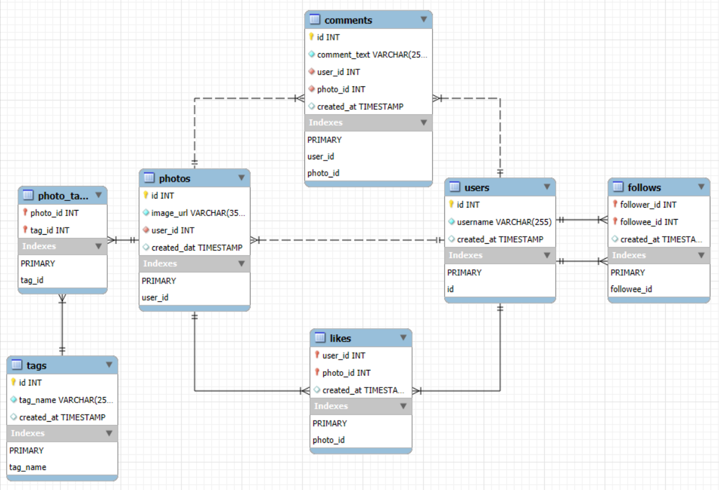
DATABASE SCHEMA

Slide 8
INSTAGRAM PROJECT OVERVIEW
Help Instagram marketing team develop strategies to increase
User Engagement
User Retention
User acquisition
Tools Used: MySQL Workbench, MS-Office, IG_Clone DB

Slide 9
DATA CLEANING
Finding Null : Nulls in relational fields is checked using “WHERE”
Finding Duplicate: Used GROUP BY + HAVING COUNT(*) > 1
Trimmed Whitespaces: Used TRIM()
Standardizing text format: Used LOWER()
Verified Foreign Key Consistency : Used WHERE and NOT IN
Updated Column name for Consistency: Used ALTER TABLE and CHANGE COLUMN

Slide 10
METRICS DEFINED
Metric | Definition
Engagement Score - | Weighted score: (comments × 2) + (posts × 3) + (likes × 1)
Engagement Rate - | Ratio: (Likes + Comments) / Posts
User Age - | Days since account creation.
Inactivity Score - | A score of 0 indicates no engagement activity.
Tag Performance - | Average engagement (likes + comments) for posts with a specific tag.

Slide 11
DATA OVERVIEW
Total Users : 100
Total Likes : 8782
Total Comments : 7488
Total Photos : 257
Total Tags : 21
Total Photos * Tagged : 501

Slide 12
USER COMMENTS ENGAGEMENT
Significant No-End Activity: 0 Comments
Around 23 users have made No comments.
These users are either new or not engaged.
Negligible Presence in 41–50 and 51–60 Buckets
Very few users lie in these intervals, showing a “gap zone” in comment volume
Moderate Commenters: 61–70 Range
Nearly 20 users fall into this range — forming a healthy middle segment of consistent engagers.
Comment Hotspot: 71–80 Comments
The highest number of users (~37 users) fall in the 71–80 comment range.
Indicates a significant cluster of highly interactive users who frequently engage with content
Sharp Drop-off in 81–90 Range
User count drastically declines for 81–90 comments (only 1–2 users), suggesting a ceiling in typical engagement.
High-Volume Commenters Exist: 251–260 Comments
Interestingly, 13 users fall into this high-comment bracket — indicating a small but impactful group of power commenters.

Slide 13
USER PHOTO’S POST ENGAGEMENT
Majority of Users Are Low Contributors
26 users (highest count) have posted 0 photos — indicating either dormant or newly registered accounts.
These users are highly inactive and represent potential for re-engagement.
Decline in Users with Higher Post Counts
There's a sharp drop-off after 5 posts — very few users contribute regularly beyond that.
Only one user each has posted 9, 10, 11, or 12 times — showing content creation beyond 8 posts is rare.
Moderate Activity Plateau (1–5 Posts)
A moderate number of users fall in the 1–5 post range:
18 users posted once
13–14 users each for 2, 4, 5 posts
Indicates typical user behavior is to test the platform but not sustain frequent posting.
Only a Small Core of Active Creators
Only 6 users posted more than 6 photos, suggesting a very small core of consistent creators.
Opportunity for Retention & Content Growth
Users in the 1–2 post range may be nudged toward more engagement with notifications, trending tags, or creator challenges.
Encourage existing creators (5+ posts) with recognition or analytics to increase posting further.

Slide 14
USER LIKES ENGAGEMENT
Low Activity Group: < 1 Like
23 users have liked less than 1 post, suggesting either:
Newly joined users
Passive consumers
These users are ideal candidates for re-engagement efforts
Very Low Engagement in Ranges (61–70 & 101–110)
Only 1 user in each of these ranges suggests discontinuity or natural behavioral cutoffs.
Mid-Level Users (81–100 Likes)
Combined ~27 users (13 in 81–90 and 14 in 71–80) are fairly active.
They show promising engagement behavior—could be converted into power users with small nudges.
Most Users Like Frequently (91–100 Range)
35 users, the largest group, fall in the 91–100 likes range.
This indicates a strong culture of engagement—users are highly responsive to content.
High Engagement Bracket: 251–260 Likes
13 users consistently engage at very high levels, liking over 250 posts.
These are your superfans or platform champions.

Slide 15
TOP TAGS WISE USER ENGAGEMENT
Top 3 Most Popular Tags:
#smile (59 posts) — highest usage, indicating positive and universally relatable content.
#beach (42 posts) — suggests high visual appeal and seasonal relevance.
#party (39 posts) — signifies social & celebratory content is widely shared.
Entertainment & Emotion-Oriented Tags Dominate:
Tags like #fun, #lol, #concert, and #happy reflect user preference for emotionally expressive and experience-driven content.
Lifestyle Tags Also Perform Well:
#hair, #beauty, and #food — all have 20–24 posts, indicating interest in personal and lifestyle topics.
Balanced Usage Across Mid-Range Tags:
Multiple tags (e.g., #food, #concert, #lol) are used consistently across ~24 posts each, showing diverse engagement without overconcentration.

Slide 16
USER SEGMENTATION
Active Creators Lead the Platform (35%)
The largest segment is Active Creators, indicating a healthy base of users who post content consistently.
These users drive fresh content and keep the platform visually alive.
Likers & Commenters Are Also Significant (31%)
This segment represents users who don’t post often, but are highly active in engaging with others' content.
They are essential for maintaining community interaction and feedback loops.
Passive Users Make Up Nearly a Quarter (23%)
These users have minimal engagement: few posts, likes, or comments.
They represent the largest opportunity for growth through acquisition strategies.
Influencers Are a Small but Valuable Group (11%)
Though only 11%, they have high engagement rates and follower counts.
This group can drive campaigns, influence trends, and boost visibility when activated strategically.

Slide 17
USER POSTS ENGAGEMENT STRATEGIES
Insight | Recommendation
High percent of 0-post users- | Welcome posts, or “post your first photo” badges.
Drop-off after 5 posts - | Intro Gamification (streaks, achievements) for frequent posting.
Low power creator count - | Offer creator tools or advance tools
Boost from 1–2 post users = | Recommend content topics, use trending tags.

Slide 18
USER LIKES ENGAGEMENT STRATEGIES
Insights | Recommendation
91–100 range is the peak - | Introduce “Top Engagers” badges
251–260 users are power users - | Offer incentives, or involve them in beta features.
<1 like users - | Run onboarding tutorials or suggest content to like immediately.
81–100 range - | Encourage streak-based challenges to push them above 100+.

Slide 19
USER COMMENTS ENGAGEMENT STRATEGIES
Insights | Recommendation
Peak in 71–80 comments - | Retain these users (badges).
Large group under 40 comments - | Send notifications: “Start the conversation” or trending comment threads.
High-end users (251–260) - | Involve them in comment-based challenges.
Low density in 41–60 range - | Use micro-goals to help users past this engagement plateau (e.g., “Reach 50 comments and unlock a badge”).

Slide 20
TAGS WISE USER ENGAGEMENT STRATEGIES
Insights | Recommendation
#smile and #beach are top tags - | Promote them in trending sections or tag suggestions.
Emotional & fun tags dominate - | Recommend such tags to new users to boost initial engagement.
Lifestyle tags have steady use - | Build themed campaigns around beauty, food, and events.
Diverse tag use - | Encourage multi-tag use to expand content discoverability.

Slide 21
USER SEGMENT WISE ENGAGEMENT STRATEGIES
Insights | Recommendation
Active Creators - | Recognize top posters, offer creator insights, or promote trending tools.
Likers & Commenters - | Encourage them to post more using featured prompts or content suggestions.
Passive Users - | Trigger onboarding nudges, suggest follow connections, or send activity-based alerts.
Influencers - | Leverage them in brand/in-app campaigns and provide exclusive features.

Slide 22
STRATEGIC RECOMMENDATIONS
Insights | Recommendation
Retention - | Badge system, post reminders, personalized content nudges.
Engagement - | Boost posts with trending tags, prompt posts during peak hours.
Acquisition - | Enhance onboarding with "suggested users," promote popular tags.

Slide 23


